Slide 1
Project #1 Final Demo: $1 Algorithm, Unistroke Data Group 11: Jagan Dwarampudi, Mohammad Shameer
Python
CIS6930 Human-Centered Input Recognition Algorithms Instructor: Dr. Lisa Anthony, Spring 2023
March 21, 2023

Slide 2
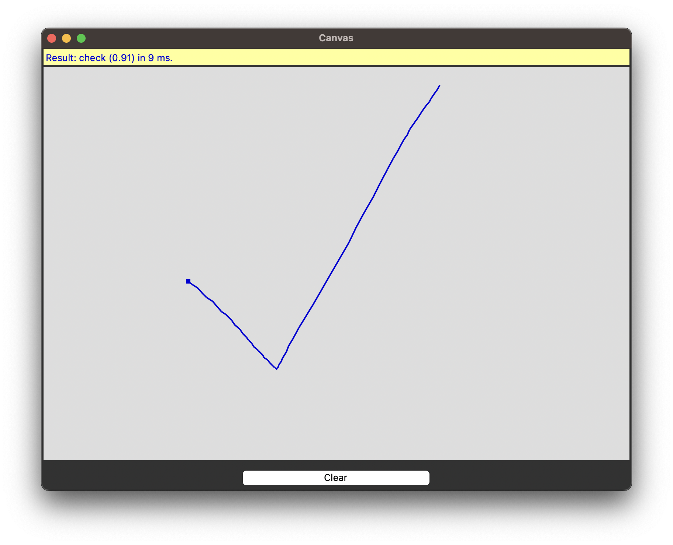
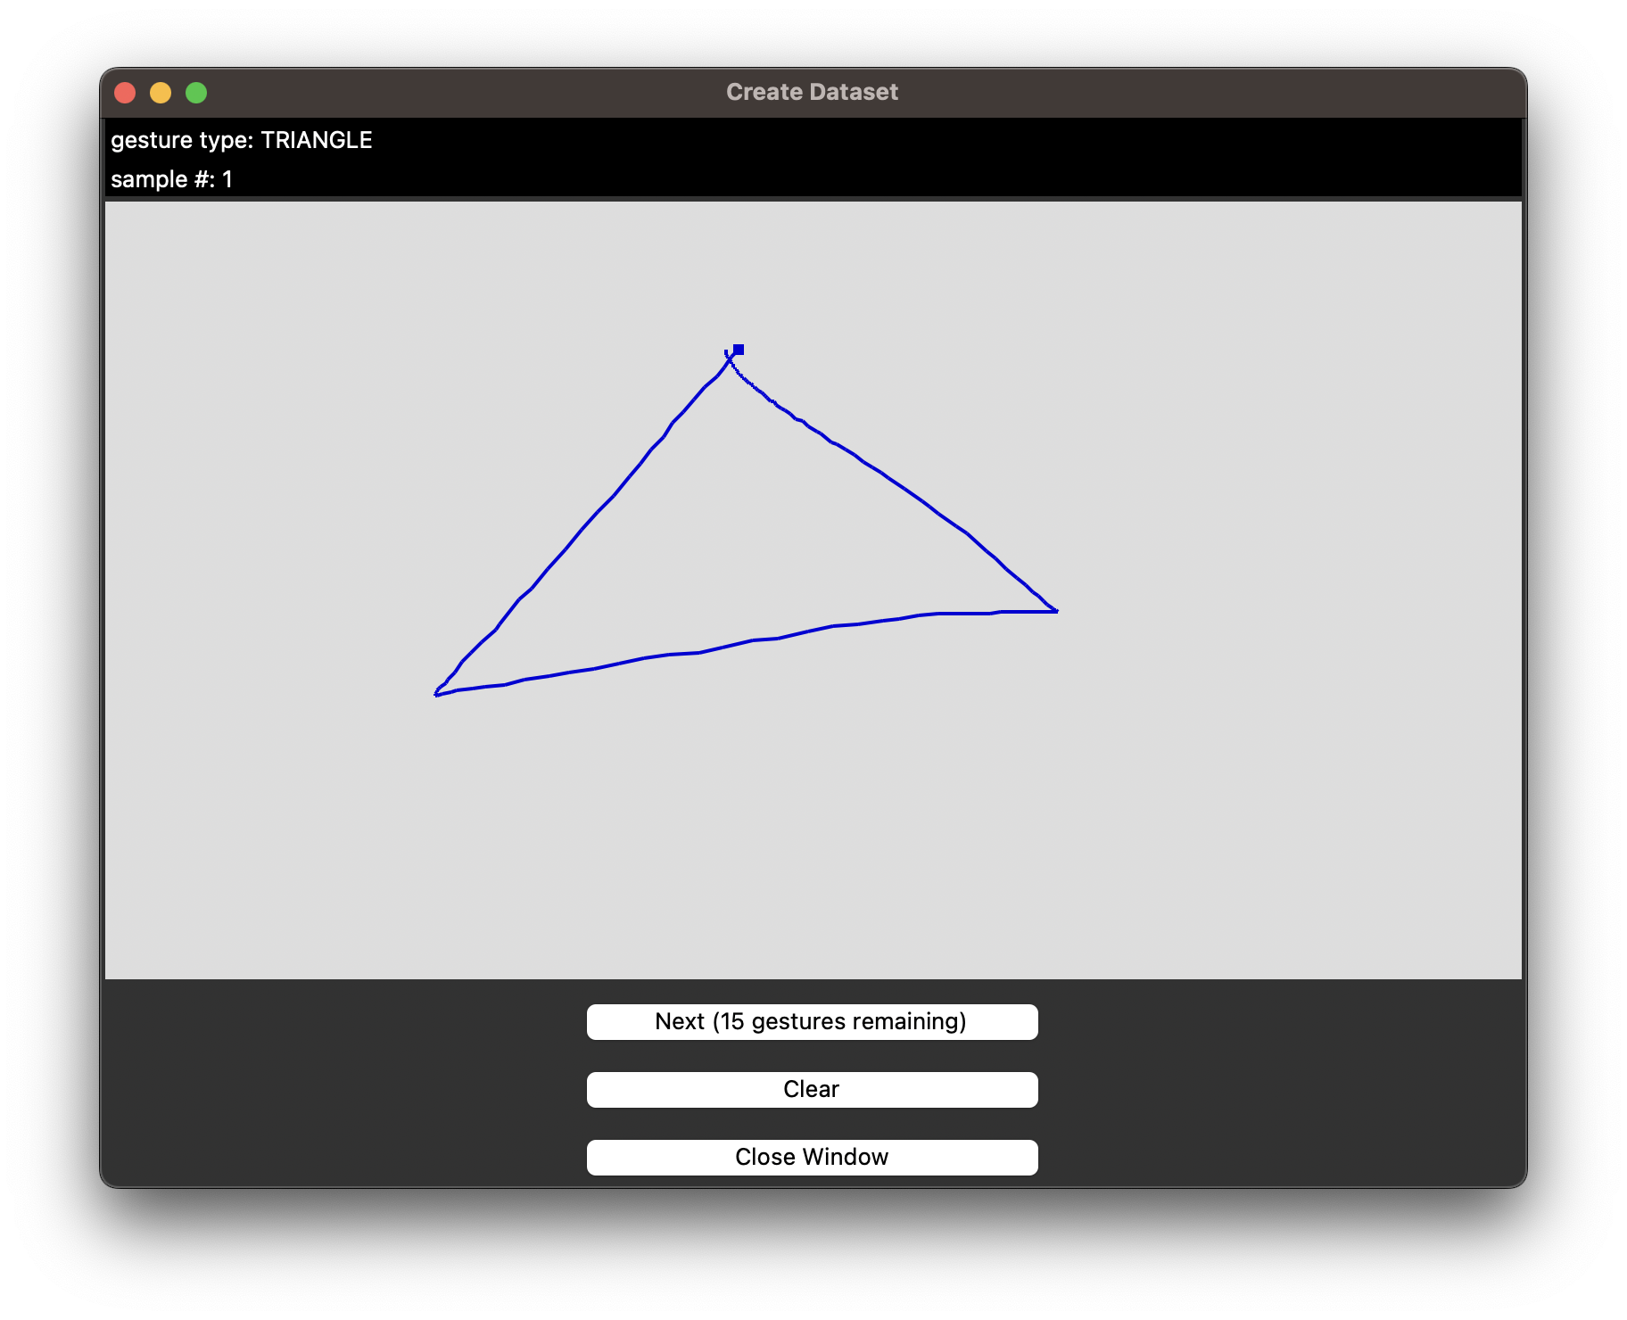
GUI Implementation
key screenshot of our live recognition app from Part 2
key screenshot of our data collection app from Part 4

Slide 3
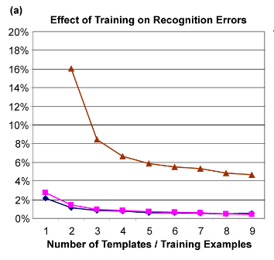
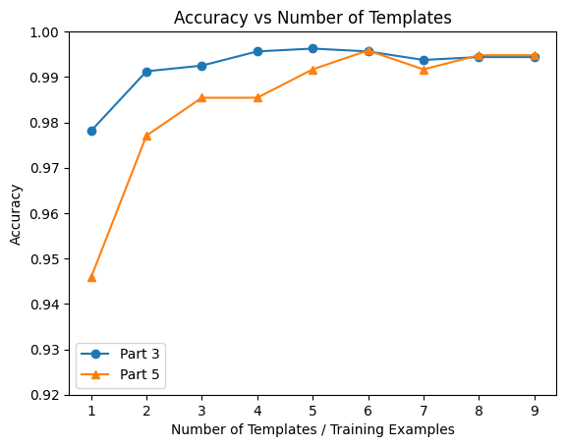
Offline Recognition Tests
Figure 9(a) from $1 paper
Plot of accuracies with increasing examples

Slide 4
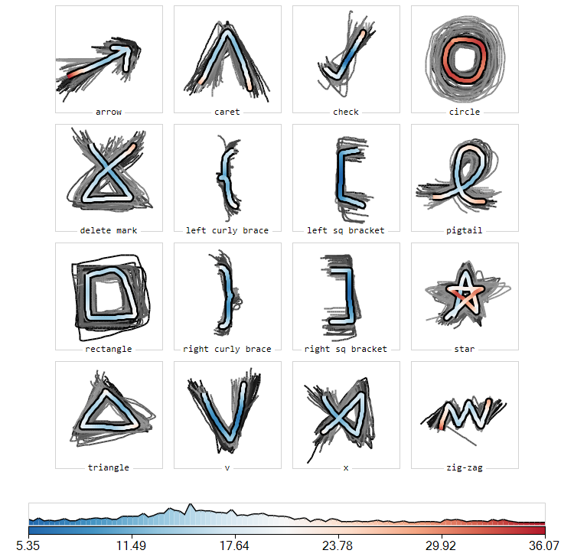
Gesture Heatmaps
Gestures with curves had more variation.
Star having many intersections may have been confusing for users.
Gestures having extended open-ended lines showed slight deviation as the line length extended.

Slide 5
Implementation and Challenges
Choosing the right data structure for Part 3 was hard. Decided to go with dictionary but again, for having unique keys, we had to set a standard for the key structure.
In Part 4, we had to decide on user dataset naming convention. So, we implemented a checking function that looks for existing user directories and creates a new user folder whenever a new dataset is being created.

Slide 6
The End!

